Slide 1
Black Box Testing Techniques
Chala Urgessa

Slide 2
Black Box Testing Techniques
Introduction
Equivalence Partitioning
Boundary Value Analysis
Decision Table Testing
State Transition Testing
Use Case Testing
Prepared by:
Chala Urgessa

Slide 3
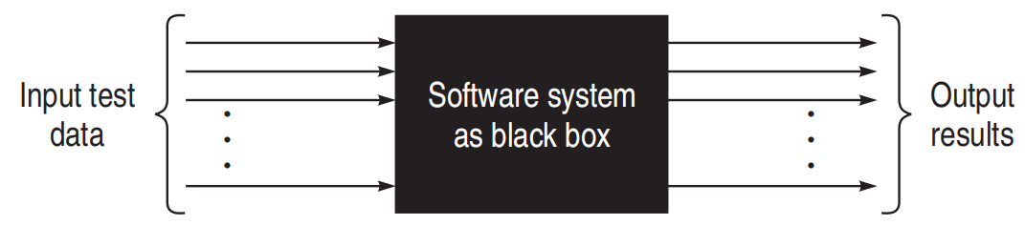
Functional Testing
Fig: Black box testing

Slide 4
Black Box Testing Introduction
Black box testing attempts to derive sets of inputs that will fully exercise all the functional requirements of a system. It is not an alternative to white box testing.
This type of testing attempts to find errors in the following categories:
  incorrect or missing functions,
  interface errors,
  errors in data structures or external database access,
  performance errors,
  initialization and termination errors.

Slide 5
Black Box Testing Introduction
Tests are designed to answer the following questions:
  How is the function's validity tested?
  What classes of input will make good test cases?
  Is the system particularly sensitive to certain input values?
  How are the boundaries of a data class isolated?
  What data rates and data volume can the system tolerate?
  What effect will specific combinations of data have on system operation?

Slide 6
Black Box Testing Introduction
White box testing should be performed early in the testing process, while black box testing tends to be applied during later stages. Test cases should be derived which:
  reduce the number of additional test cases that must be designed to achieve reasonable testing, and
  tell us something about the presence or absence of classes of errors, rather than an error associated only with the specific test at hand.

Slide 7
Equivalence Partitioning
It is a good all-round specification-based black-box technique. It can be applied at any level of testing and is often a good technique to use first.
It is a common sense approach to testing, so much so that most testers practice it informally even though they may not realize it.
The idea behind the technique is to divide (i.e. to partition) a set of test conditions into groups or sets that can be considered the same

Slide 8
Equivalence Partitioning
等价划分
Equivalence partitioning is a way to test software easily. Here's how it works:
  We divide tests into groups (partitions).
  We assume all tests in one group act the same.
  So, we just test one thing in each group. If that test works, we think everything in the group works. If it doesn't work, we think nothing in the group works.
This saves time because we don't test everything.
Remember, this is a basic idea. It might not always be perfect, but it helps us start testing.
If possible, try a few tests in each group to be sure, especially for things users do a lot.
This method makes testing faster and helps us focus on what to test first.

Slide 9
Equivalence Partitioning
Equivalence Partitioning is a smart way to test software with less work. Here's the idea:
Imagine all the things we can test in a program as a big set of inputs.
We break this big set into smaller sets, called equivalence classes.
We think all inputs in one small set behave the same way in the program.
So, we pick just one input (a representative) from each set to test. If this test passes, we guess that all inputs in that set would also pass.
This doesn't mean we're 100% sure, but it's a good guess that saves a lot of time.
Testing like this lets us cover more ground with fewer tests.
It's a smart shortcut: test one, infer about many. This way, we can efficiently check if the software does what it should with different kinds of inputs.

Slide 10
Equivalence Partitioning
Two steps are required to implementing this method:
The equivalence classes are identified by taking each input condition and partitioning it into valid and invalid classes. For example, if an input condition specifies a range of values from 1 to 999, we identify one valid equivalence class [1<item<999]; and two invalid equivalence classes [item<1] and [item>999]
Generate the test cases using the equivalence classes identified in the previous step. This is performed by writing test cases covering all the valid equivalence classes. Then a test case is written for each invalid equivalence class so that no test contains more than one invalid class. This is to ensure that no two invalid classes mask each other.

Slide 11
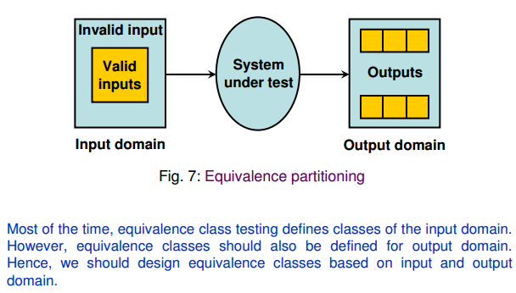
Equivalence Partitioning

Slide 12
Example 3.1
Consider a program for the determination of the nature of roots of a
quadratic equation. Its input is a triple of positive integers (say a,b,c) and values may be from interval [0,100]. The program output may have one of the following words.
[Not a quadratic equation; Real roots; Imaginary roots; Equal roots]
Identify the equivalence class test cases for output and input domains.

Slide 13
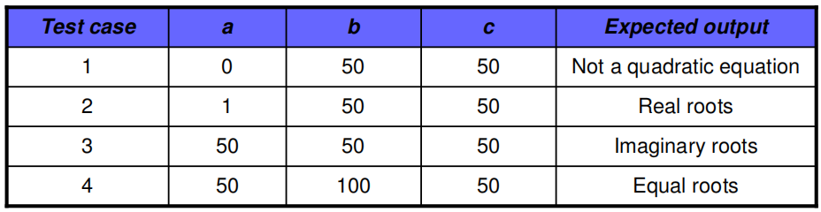
Solution
Output domain equivalence class test cases can be identified as follows:
  O1={<a,b,c>:Not a quadratic equation if a = 0}
  O1={<a,b,c>:Real roots if (b²-4ac)>0}
  O1={<a,b,c>:Imaginary roots if (b²-4ac)<0}
  O1={<a,b,c>:Equal roots if (b²-4ac)=0}`
The number of test cases can be derived form above relations and shown below:

Slide 14
Cont ...
We may have another set of test cases based on input domain.
  I1= {a: a = 0}
  I2= {a: a < 0}
  I3= {a: 1 ≤ a ≤ 100}
  I4= {a: a > 100}
  I5= {b: 0 ≤ b ≤ 100}
  I6= {b: b < 0}
  I7= {b: b > 100}
  I8= {c: 0 ≤ c ≤ 100}
  I9= {c: c < 0}
  I10={c: c > 100}

Slide 15
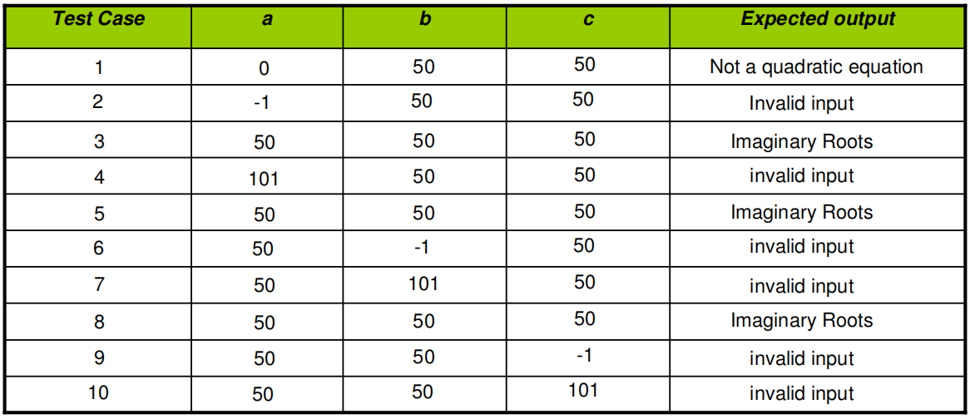
Here test cases 5 and 8 are redundant test cases. If we choose any value other than nominal, we may not have redundant test cases. Hence total test cases are 10+4=14 for this problem.

Slide 16
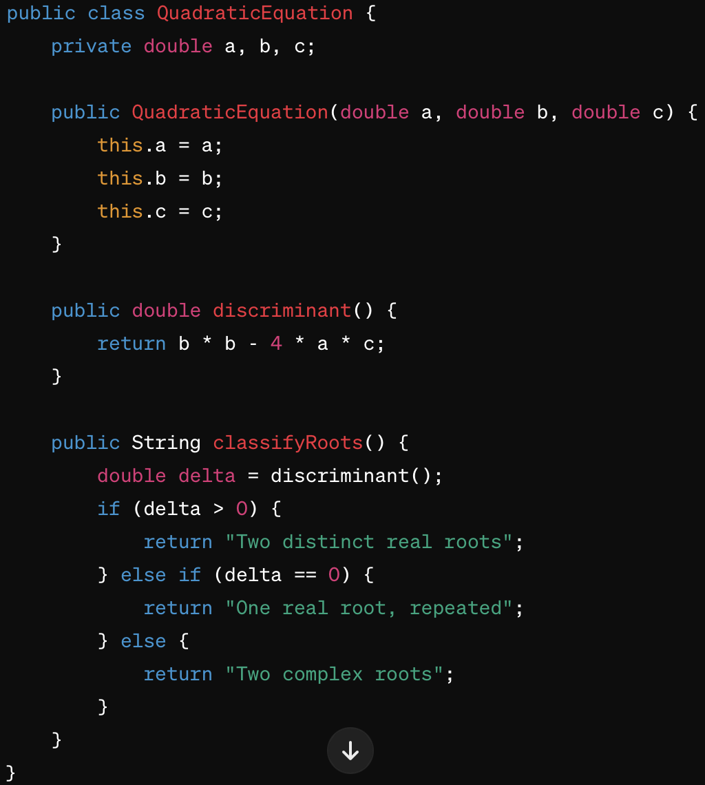

Slide 17
Step 1: Create Tests with JUnit 5
First, ensure you have JUnit 5 added to your project's dependencies. If you're using Maven, add the following dependency to your pom.xml:
<dependency>
<groupId>org.junit.jupiter</groupId>
<artifactId>junit-jupiter</artifactId>
<version>5.7.0</version>
<scope>test</scope>
</dependency>

Slide 18
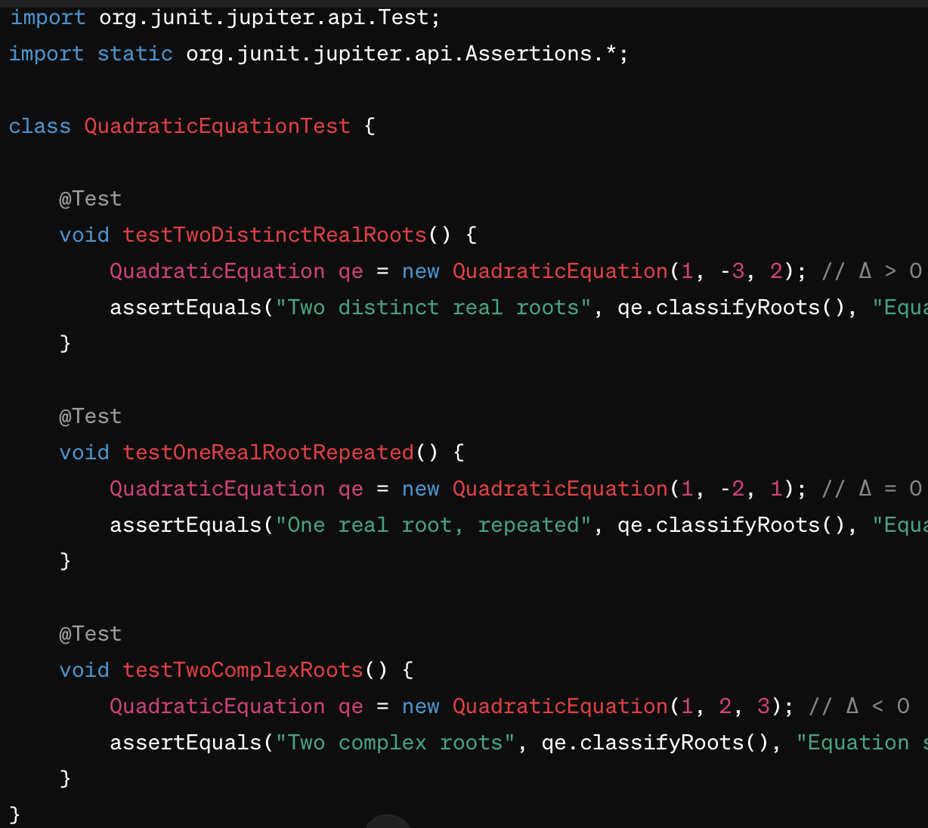

Slide 19
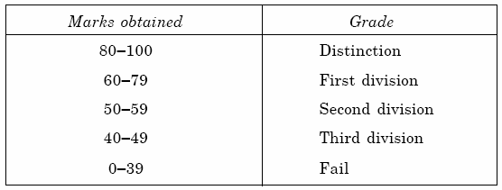
Example 3.2. Class Activity
Let us consider an example of grading the students in an academic institution. The grading is done according to the following rules:
Generate test cases using equivalence class testing technique and write the implementation alongside.

Slide 20
Solution
1. Valid Equivalence Classes
VE1: 80-100 (inclusive) for “Distinction”
...
2. Invalid Equivalence Classes
IE1: Marks below 0 (negative marks)
IE2: Marks above 100

Slide 21
Implementation
public void testInvalidMarksAboveHundred() {
Assertions.assertEqual(“Invalid marks”, calculator.calculateGrade(101));
}

Slide 22
Example 3.3: Homework
Consider a program for determining the Previous date. Its input is a triple of day, month and year with the values in the range
1 ≤ month ≤ 12
1 ≤ day ≤ 31
1900 ≤ year ≤ 2025
The possible outputs would be Previous date or invalid input date. Identify the equivalence class test cases for output & input domains.

Slide 23
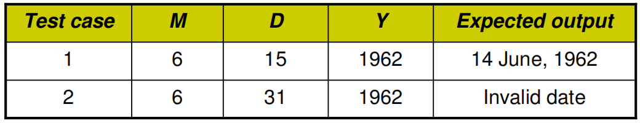
Solution
Output domain equivalence class are:
O1={<D,M,Y>: Previous date if all are valid inputs}
O1={<D,M,Y>: Invalid date if any input makes the date invalid}

Slide 24
We may have another set of test cases which are based on input domain.
I1={month: 1 ≤ m ≤ 12}
I2={month: m < 1}
I3={month: m > 12}
I4={day: 1 ≤ D ≤ 31}
I5={day: D < 1}
I6={day: D > 31}
I7={year: 1900 ≤ Y ≤ 2025}
I8={year: Y < 1900}
I9={year: Y > 2025}

Slide 25
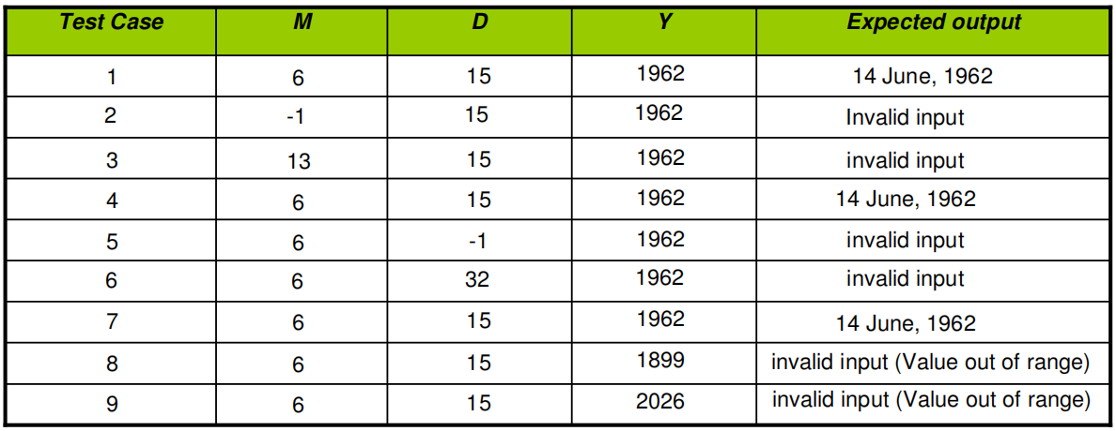
Inputs domain test cases are :

Slide 26
Boundary Value Analysis (BVA)
This method leads to a selection of test cases that exercise boundary values. It complements equivalence partitioning since it selects test cases at the edges of a class. Rather than focusing on input conditions solely, BVA derives test cases from the output domain also.
Characteristics:
  Large number of errors tend to occur at boundaries of the input domain.
  BVA leads to selection of test cases that exercise boundary values.
  BVA complements equivalence partitioning. Rather than select any element in an equivalence class, select those at the ''edge' of the class.

Slide 27
Boundary Value Analysis
Boundary Value Analysis Guidelines
For input ranges bounded by a and b, test cases should include values a and b and just above and just below a and b respectively.
If an input condition specifies a number of values, test cases should be developed to exercise the minimum and maximum numbers and values just above and below these limits.
Apply guidelines 1 and 2 to the output.
If internal data structures have prescribed boundaries, a test case should be designed to exercise the data structure at its boundary.

Slide 28
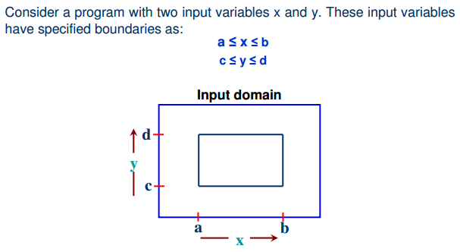
Boundary Value Analysis

Slide 29
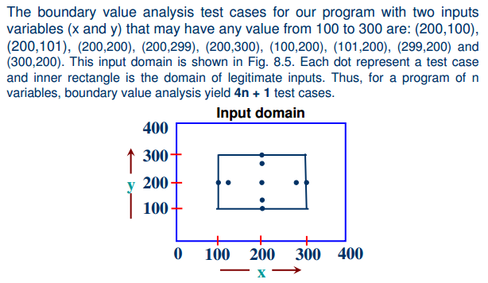
Boundary Value Analysis
Back to Main

Slide 30
Example 3.4
Consider a program for the determination of the nature of roots of a
quadratic equation. Its input is a triple of positive integers (say a,b,c) and values may be from interval [0,100]. The program output may have one of the following words.
[Not a quadratic equation; Real roots; Imaginary roots; Equal roots]
Design the boundary value test cases.

Slide 31
Solution
Quadratic equation will be of type:
ax²+bx+c=0
Roots are real if (b²-4ac)>0
Roots are imaginary if (b²-4ac)<0
Roots are equal if (b²-4ac)=0
Equation is not quadratic if a=0

Slide 32
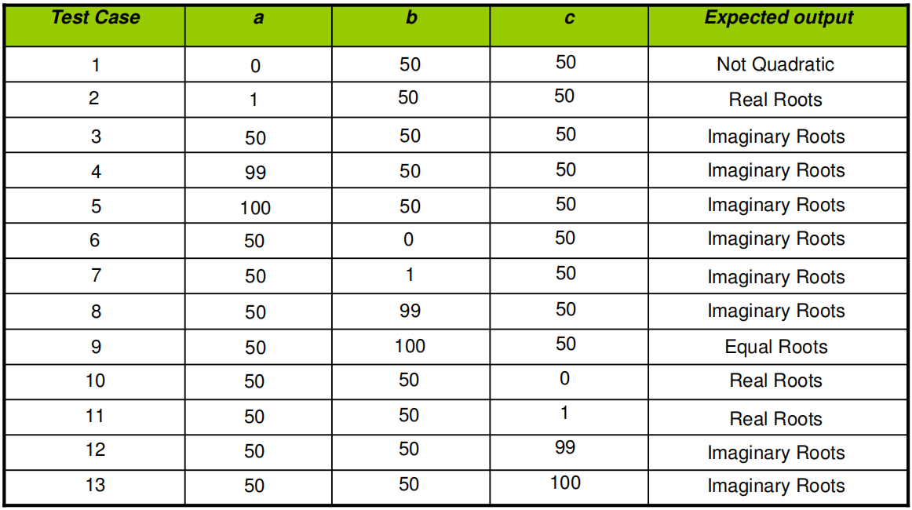
Solution (cont...)
The boundary value test cases are :

Slide 33
Example 3.5: Class Activity
Consider a program for determining the Previous date. Its input is a triple of day, month and year with the values in the range
1 ≤ month ≤ 12
1 ≤ day ≤ 31
1900 ≤ year ≤ 2025
The possible outputs would be Previous date or invalid input date. Design the boundary value test cases.

Slide 34
Solution
The Previous date program takes a date as input and checks it for validity. If valid, it returns the previous date as its output.
With single fault assumption theory, 4n+1 test cases can be designed and which are equal to 13.

Slide 35
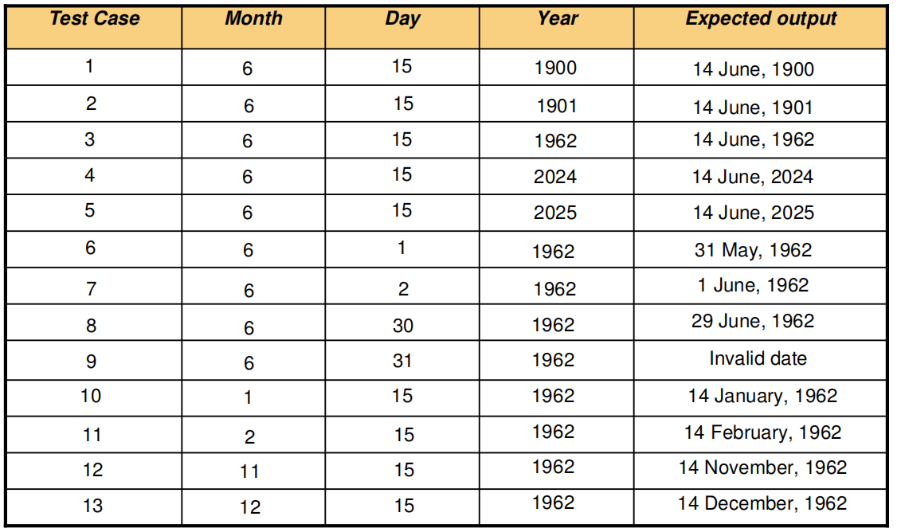
Cont ...
The boundary value test cases are:

Slide 36
Robustness Testing
It is nothing but the extension of boundary value analysis. Here, we would
like to see, what happens when the extreme values are exceeded with a
value slightly greater than the maximum, and a value slightly less than
minimum.
  It means, we want to go outside the legitimate boundary of input domain. This extended form of boundary value analysis is called robustness testing and shown in next slide.

Slide 37
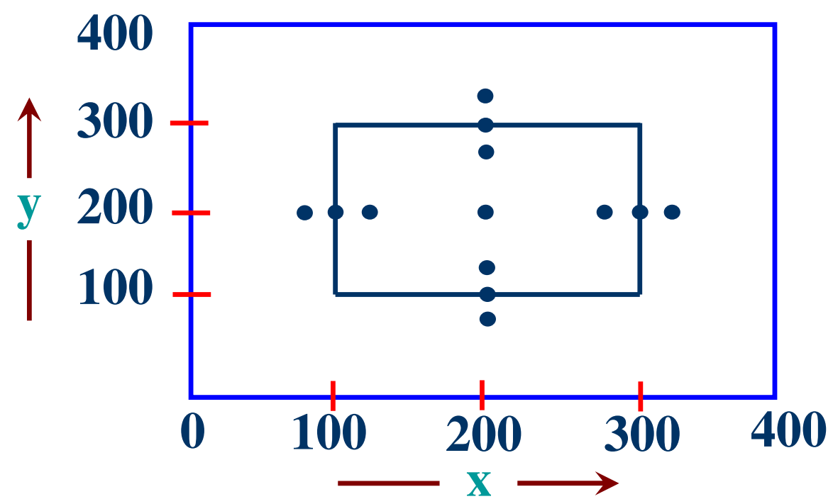
BVA Robustness Testing
There are four additional test cases which are outside the legitimate input
domain. Hence total test cases in robustness testing are 6n+1, where n is
the number of input variables. So, 13 test cases are:
(200,99), (200,100), (200,101), (200,200), (200,299), (200,300)
(200,301), (99,200), (100,200), (101,200), (299,200), (300,200), (301,200)
Robustness test cases for two variables x and y with range [100, 300] each

Slide 38
Worst-case testing
If we reject “single fault” assumption theory of reliability and may like to see
what happens when more than one variable has an extreme value. In
electronic circuits analysis, this is called “worst case analysis”. It is more
thorough in the sense that boundary value test cases are a proper subset
of worst case test cases. It requires more effort. Worst case testing for a
function of n variables generate 5n test cases as opposed to 4n+1 test
cases for BVA. Our two variables example will have 5^{n}=25 test cases and are given in table as shown in next slide.

Slide 39
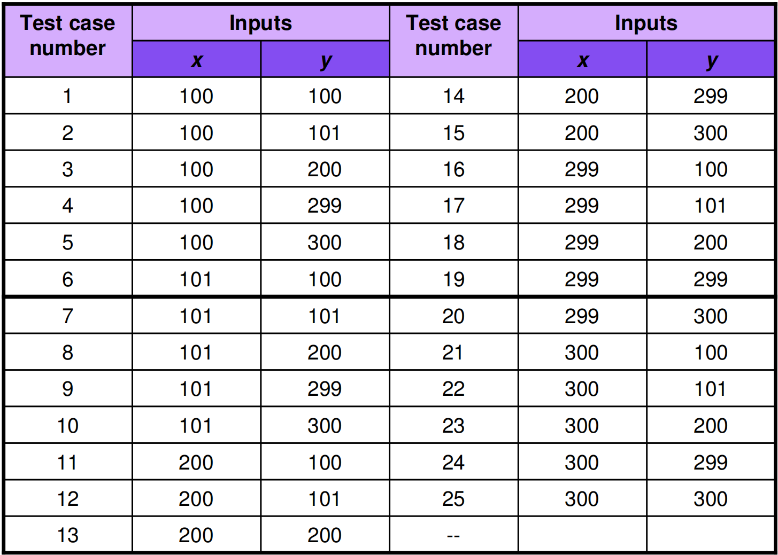
Table: Worst cases test inputs for two variables example

Slide 40
Example 8.4
Consider the program for the determination of nature of roots of a quadratic equation as explained in example 3.1. Design the Robust test case and worst test cases for this program.

Slide 41
Solution
github (robust_test_case.md)

Slide 42
Example 8.5: Home Work
Consider the program for the determination of previous date in a calendar as explained in example 3.3. Design the robust and worst test case for this program

Slide 43
Decision Table Testing
A decision table is a good way to deal with combinations of things (e.g. inputs). This technique is sometimes also referred to as a 'cause-effect' table. The reason for this is that there is an associated logic diagramming technique called 'cause-effect graphing' which was sometimes used to help derive the decision table

Slide 44
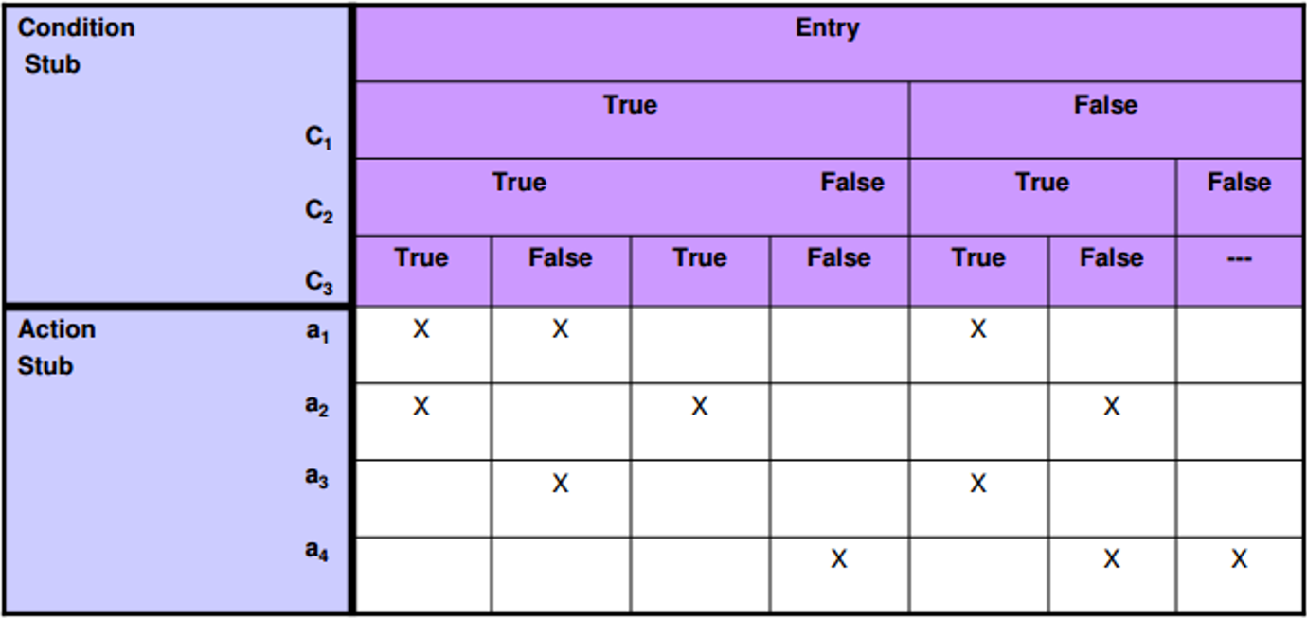
Decision Table Testing
Condition stub It is a list of input conditions for which the complex combination
is made.
Action stub It is a list of resulting actions which will be performed if a combination
of input condition is satisfi ed.

Slide 45
Decision Table Testing
Step 1. The first task is to identify a suitable function or subsystem that has a behavior which reacts according to a combination of inputs or events. It is better to deal with large numbers of conditions by dividing them into subsets and dealing with the subsets one at a time.
Step 2. Once you have identified the aspects that need to be combined, then you put them into a table listing all the combinations of True and False for each of the aspects.
Step 3. The next step is to identify the correct outcome for each combination.

Slide 46
Decision Table Testing
Credit card worked example
If you are a new customer opening a credit card account, you will get a 15% discount on all your purchases today. If you are an existing customer and you hold a loyalty card, you get a 10% discount. If you have a coupon, you can get 20% off today (but it can't be used with the 'new customer' discount). Discount amounts are added, if applicable.

Slide 47
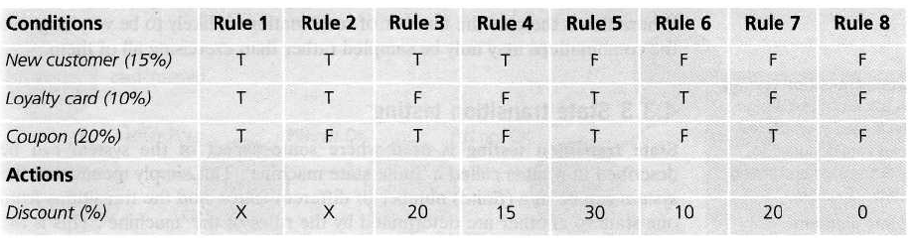
Decision Table Testing
Back to Main

Slide 48
Decision Table Testing cont…
Consider a simple program to classify a triangle. Its inputs is a triple of positive integers (say x, y, z). The program output may be one of the following words:
[Scalene; Isosceles; Equilateral; Not a triangle; Impossible]
Draw the Decision table and design the test cases.

Slide 49
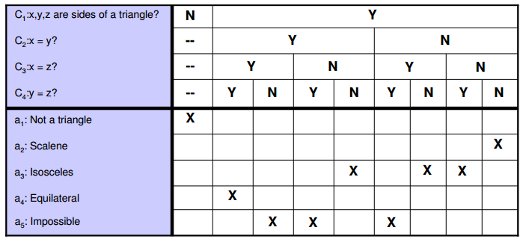
Decision Table Testing cont…
a. Decision Table

Slide 50
Decision Table Testing cont…
b. Test Cases
Test Case | x | Y | z | Output
1 | - | - | - | Not a Triangle
2 | 2 | 2 | 2 | Equilateral
3 | - | - | - | Impossible
4 | - | - | - | Impossible
5 | 2 | 2 | 1 | Isosceles
6 | - | - | - | Impossible
7 | 2 | 1 | 2 | Isosceles
8 | 1 | 2 | 2 | Isosceles
9 | 3 | 4 | 5 | Scalene

Slide 51
State Transition Testing
State transition testing is used where some aspect of the system can be described in what is called a 'finite state machine'. This simply means that the system can be in a (finite) number of different states, and the transitions from one state to another are determined by the rules of the 'machine'. This is the model on which the system and the tests are based. Any system where you get a different output for the same input, depending on what has happened before, is a finite state system. A finite state system is often shown as a state diagram

Slide 52
State Transition Testing
A state transition model has four basic parts:
the states that the software may occupy (open/closed or funded/insufficient funds);
the transitions from one state to another (not all transitions are allowed);
the events that cause a transition (closing a file or withdrawing money);
the actions that result from a transition (an error message or being given your cash).

Slide 53
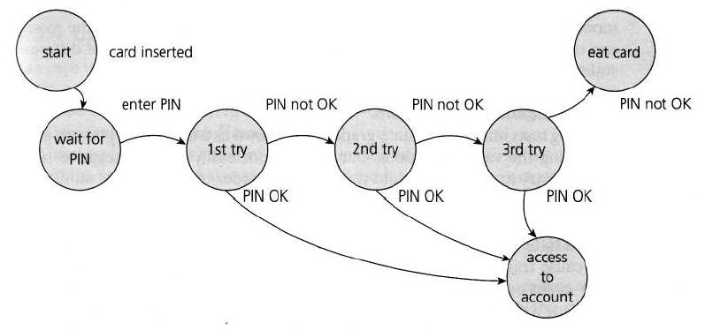
State Transition Testing
State Diagram for PIN Entry

Slide 54
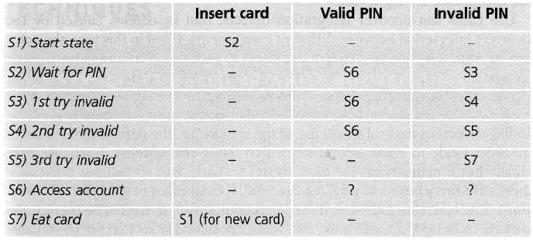
State Transition Testing
State table for the PIN example

Slide 55
Use Case Testing
Use case testing is a technique that helps us identify test cases that exercise the whole system on a transaction by transaction basis from start to finish. A use case is a description of a particular use of the system by an actor (a user of the system). Each use case describes the interactions the actor has with the system in order to achieve a specific task (or, at least, produce something of value to the user). Actors are generally people but they may also be other systems. Use cases are a sequence of steps that describe the interactions between the actor and the system.

Slide 56
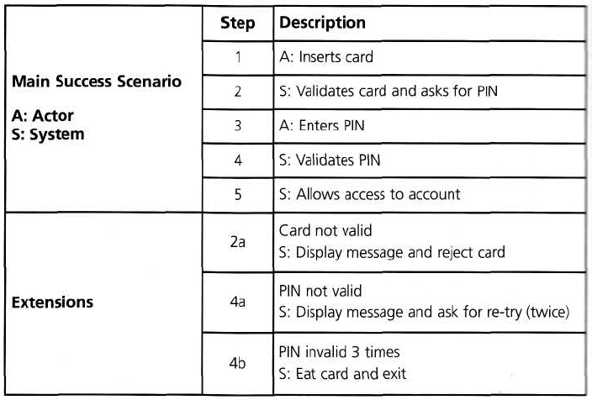
Use Case Testing
The PIN example that we used for state transition testing could also be defined in terms of use cases
Back to Main

Slide 57
When to Use What…
When you want to test scenarios that have… | The most effective black box testing technique is likely to be…
Output values are dictated by certain conditions depending upon values of input variables | Decision Tables
Input values being in ranges, with each range exhibiting a particular functionality | Boundary Value Analysis
Input values being divided into classes (like ranges, list of values, etc), with each class exhibiting a particular functionality | Equivalence Partitioning
 | Positive and negative testing
Workflows, process flows or language processors | Graph based testing
To ensure that requirements are tested and met properly | Requirements Based Testing
To test using the domain expertise rather than the product specification | Domain Testing
To ensure that the documentation is consistent with the product | Documentation Testing

Slide 58
End

